Slide 1
sEMG Signal Analysis
Test signal
New Algorithm
Experiment (Raw and envelope signal)
Curl
Isometric
Professor James McNames’s advice

Slide 2
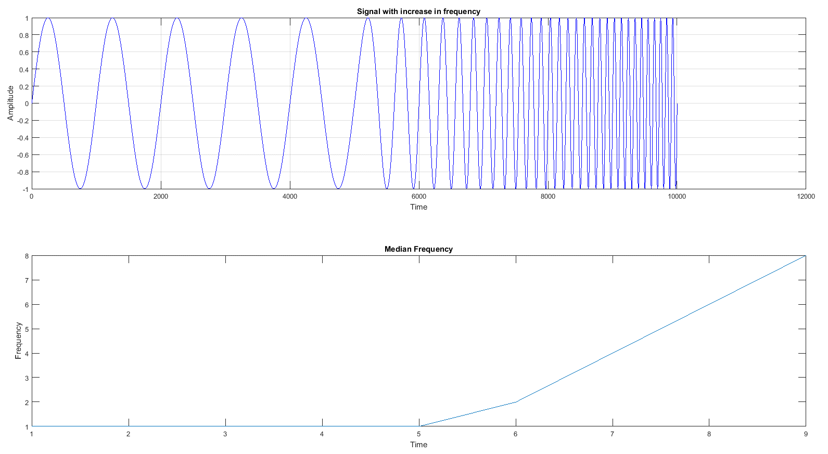
Test Signal
Test Signal
Result after using MATLAB code to compute the median frequency

Slide 3
New Algorithm
Motivation: Median frequency in MATLAB (medfreq(x,n)) is not a correct way to compute “Median Power Frequency”
Raw EMG
Import all the data into MATLAB
Shift to zero base line to rectify all the data
Envelope EMG
Split the data into consecutive windows
Perform integration to compute the area under the curve
Find the frequency that split the area in half
Apply FFT for each window

Slide 4
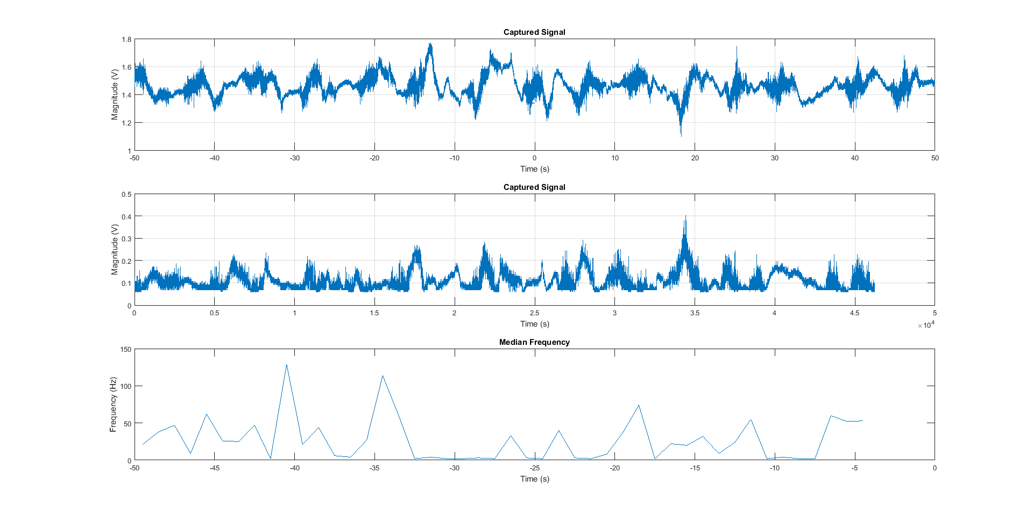
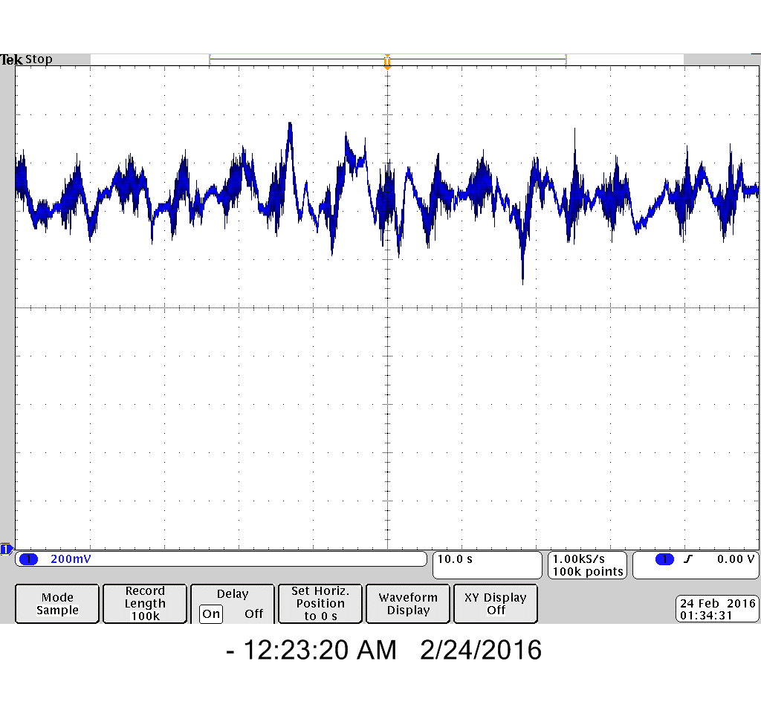
Raw Signal (Curls)
Used raw signal
Performed 15 curls, felt fatigued on curl 12
Oscilloscope sample rate: 1kHz
Raw EMG signal of the last 12 curls
Results from MATLAB

Slide 5
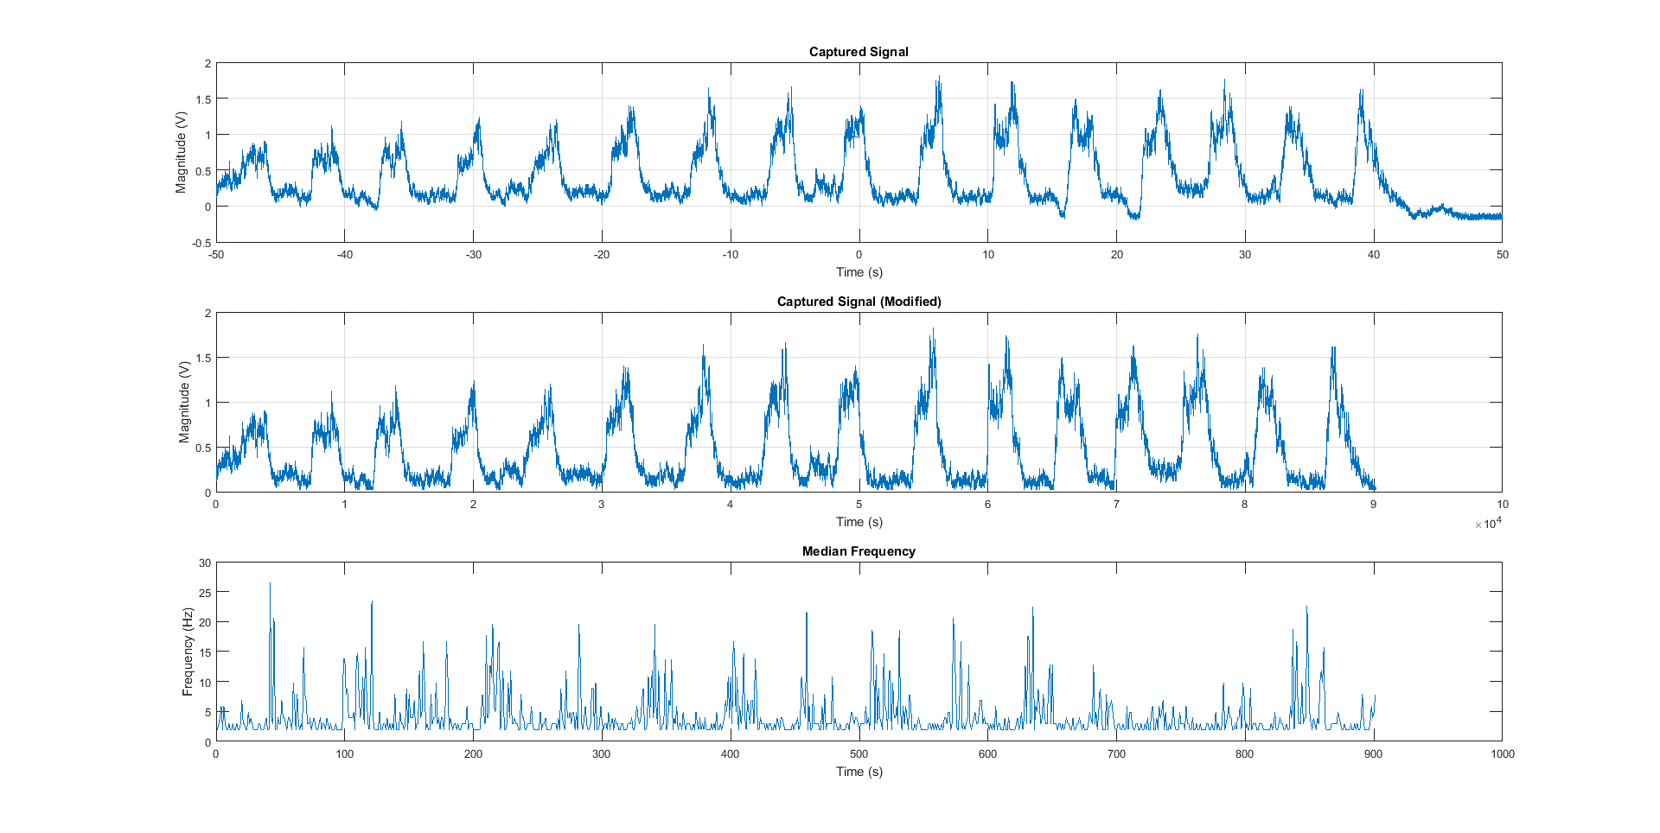
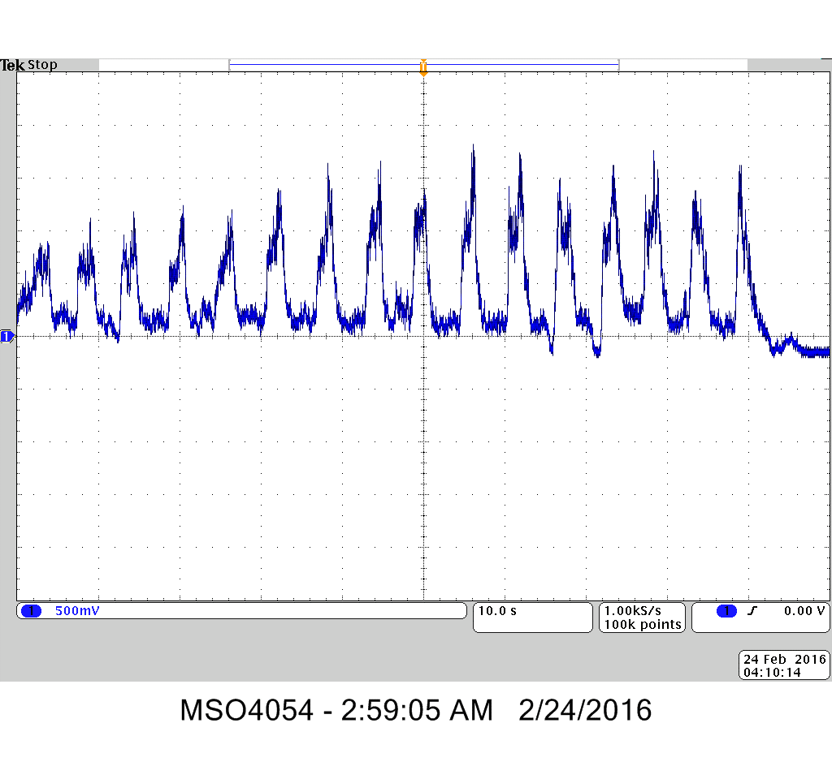
Envelope Signal (Curls)
Used envelope signal
Performed 20 curls, felt fatigued on curl 16
Oscilloscope sample rate: 1 kHz
Envelope EMG signal of the last 16 curls
Results from MATLAB

Slide 6
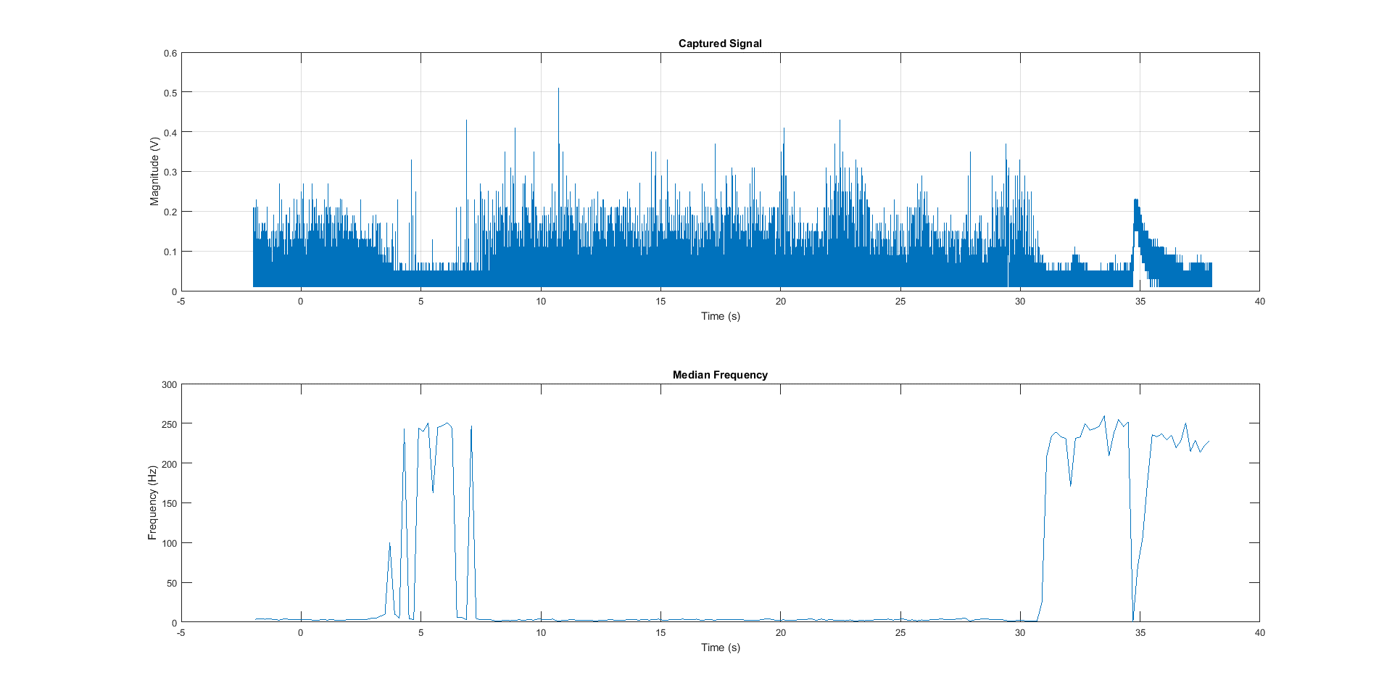
Raw Signal (Isometric)
Used raw signal
Held an object for 40s, felt fatigued for last 10s
Sample rate is 1k Hz (Oscilloscope)

Slide 7
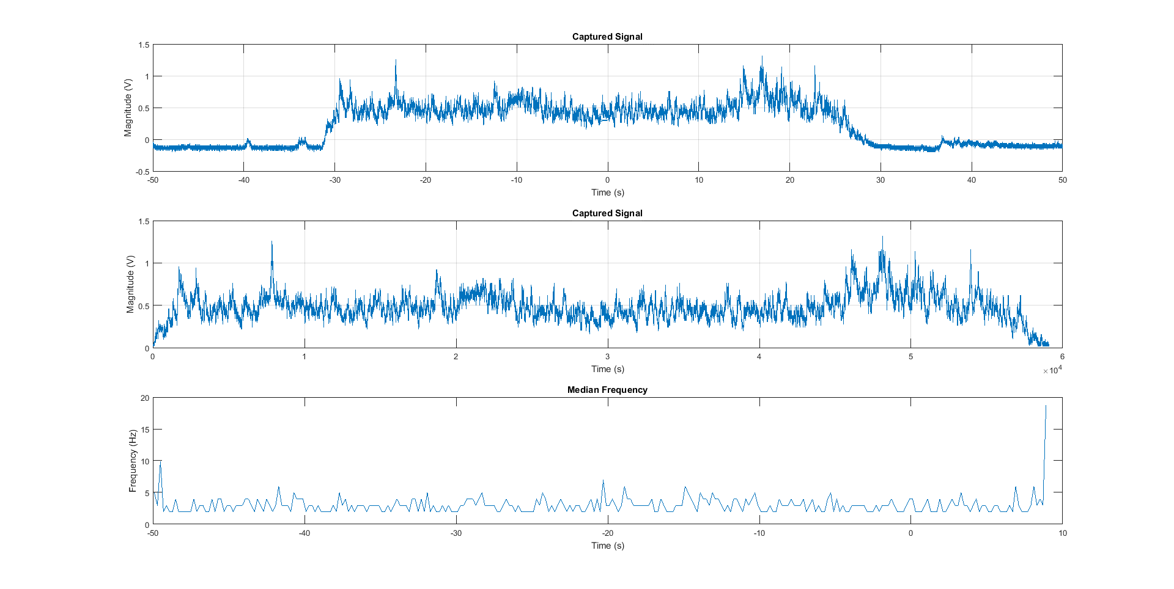
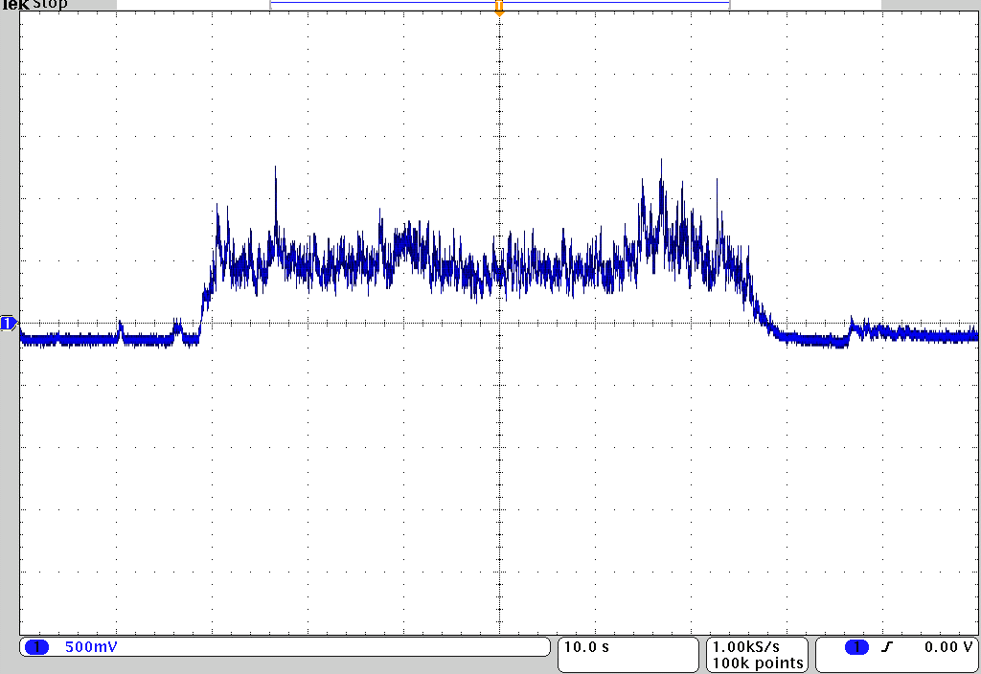
Envelope Signal (Isometric)
Used envelope signal
Held an object for 40s, felt fatigued for last 10s
Oscilloscope sample rate: 1 kHz
Envelope EMG signal
Results from MATLAB

Slide 8
Professor James McNames’s Advice
Median power frequency is not a good indicator for muscle fatigue, especially with non-isometric exercise.
Median power frequency is very sensitive to:
The location of the electrodes on the skin
The skin condition (wet, dry, hairy)
Recommended alternative way:
Using heart beat rate and breath rate to indicate muscle fatigue
Get advice from an expert:
Professor Gary Brodowicz, the director of the exercise physiology laboratory and director of the university's fitness assessment service-ON TRAC

Slide 9
Discussed Alternatives for Detecting Fatigue
Heart rate
Suggested by Prof. McNames
Would required an additional sensor
Don’t use signal properties
Instead, recommend an amount of reps
Update recommendation using actual user rep count
Increasing amplitude (time domain)
Detect increasing amplitude on fatigued repetitions
Mentioned in literature
Can be seen on envelope signal graph of curl exercise
We meet with Dr. Brodowicz on 2/25 at 11 AM

